Slide 1
Sensor Nodes for Distributed Ventilation System Control
Marin Berov Marinov ,
Georgi Todorov Nikolov and
Borislav Todorov Ganev
Faculty of Electronic Engineering and Technologies,
Technical University of Sofia, Bulgaria
Notes:
Good morning Ladies and Gentleman.
Thank you for being here today.
Let me introduce myself. My name is Marin Marinov and I’m with the Technical University Sofia, Faculty of Electronics
I'm here today to present our project called
Implementation of Innovative Air Conditioning System Using Power over Ethernet Sensor Nodes.
First I will start off with a short Introduction.
Then I will say a few words about IP network infrastructure, Power over Ethernet and will present our the sensor node.
The main focus of my presentation is the implementation of an innovative air conditioning system using this node.
And I’ll end with some concluding words.

Slide 2
Content
Introduction
IP network infrastructure
The sensor node
Implementation of the innovative air conditioning system
Conclusions

Slide 3
1. Introduction
In Europe about 40 % of the energy is consumed in buildings.
More than 50% of this consumption is in non-residential area where many buildings are equipped with air conditioning systems.
In recent decades, new construction technologies and materials have been developed which have remarkably reduced the energy losses from the buildings.
Notes:
In Europe about 40 percent of the energy is consumed in buildings.
More than 50% of this consumption is in non-residential area where many buildings are equipped with air conditioning systems.
In recent decades, new construction technologies and materials have been developed which have remarkably reduced the energy losses from the buildings.

Slide 4
1. Introduction
In this situation, sufficient indoor air quality must be guaranteed by appropriate heating, cooling and ventilation.
Decentralised climate control in the sense of heating, cooling and ventilation control which is operated separately in different rooms and areas of the buildings offers good possibilities to satisfy these demands.
Notes:
In this situation, sufficient indoor air quality must be guaranteed by appropriate heating, cooling and ventilation.
Decentralised climate control in the sense of heating, cooling and ventilation control which is operated separately in different rooms and areas of the buildings offers good possibilities to satisfy these demands.

Slide 5
1. Introduction
At present, most sensor-based demand-controlled ventilation (SBDCV) systems are based on monitoring of CO2, concentrations. CO2 sensors provide a relatively inexpensive way to indirectly monitor the indoor air quality component related to bio-effluents.
The indoor air typically contains dozens of volatile organic
compounds( VOCs) at measurable concentrations. VOCs are emitted indoors by building materials, furnishings, equipment, cleaning products, combustion activities, human metabolism, and perfumes. The outdoor air also contains VOCs that enter buildings.
Notes:
.
At present, most sensor-based demand-controlled ventilation (SBDCV) systems are based on monitoring of CO2, concentrations. CO2 sensors provide a relatively inexpensive way to indirectly monitor the indoor air quality component related to bio-effluents.

Slide 6
1. Introduction
Pollutant | Typical range indoors | Sensor minimum detection limit | Sensor resolution | Sensor maximum drift between calibration | Sensor required specificity | Maximum period between measurements
Carbon Dioxide (CO₂) | 350-2000 ppm (often <1000 ppm maximum | 350 ppm | ≤ 50 ppm | 50 ppm | Insensitive to temperature, RH ,gases | 30 min
Humidity | 10%-80% RH 0,002-0.0015 absolute himidity | 10% RH | ≤ 5% RH | 5% RH | Insensitive to temperature, other gases | 30 min
Particles in indoors with minimal smoking | 10-100 μg m⁻³ (minimal smoking) | 10 μg m⁻³ | ≤ 0.05 μg m⁻³ | 0.05 μg m⁻³ | Insensitive to temperature, gases | 30 min
Particles in smoking rooms |  | 50 μg m⁻³ | ≤ 10 μg m⁻³ | ≤ 10 μg m⁻³ | Insensitive to temperature, gases | 10 min
TVOC high limit control | 0.1-5 mg m⁻³ | 1 mg m⁻³ | ≤ 0.2 mg m⁻³ | 0.2 mg m⁻³ | Responds to total Carbon for VOC 's with 50ºC-250ºC boiling point | 30 min
TVOC routine control | 0.1-5 mg m⁻³, usually < 1 mg m⁻³ | 0.04 mg m⁻³ | 0.04 mg m⁻³ | 0.04 mg m⁻³ | Responds to total Carbon for VOC 's with 50ºC-250ºC boiling point | 30 min
Notes:
The outdoor CO2, concentration is approximately 350 ppm and indoor concentrations are usually in the range of 500-2000 ppm. At these concentrations, CO2 is not thought to be a direct cause of adverse health effects; however, CO2 is an easily measured surrogate for other occupant-generated pollutants, such as body odors. The indoor CO2, concentration is often used as an indicator of the rate of outside air supply per occupant,
Water vapor is generated indoors due to human metabolism and human activities as well as from unvented combustion. The generally accepted range in relative humidity for human comfort is approximately in 25-60%.

Slide 7
IP network infrastructure
In recent years, enterprise workspace-infrastructure has increasingly converged to IP network infrastructure.
PoE is now one of the most widely deployed technologies to provide power to networked devices.
In this article the sensor node with Power over Ethernet is further described and it is used for cost-effective implementation of an innovative air conditioning system.
Notes:
In recent years, enterprise workspace-infrastructure has increasingly converged to IP network infrastructure.
Power over Ethernet is now one of the most widely deployed technologies to provide power to networked devices.
Some of the most important benefits are:
High availability of power and guarantee of uninterrupted services – very important requirement for critical applications.
Lower operation cost for operation
by providing network resiliency at a lower cost by consolidating backup power into the wiring.
Faster deployment of new networking infrastructures by eliminating the need for a power outlet for every endpoint.
In this article the sensor node with Power over Ethernet is futher described, and it is used for cost-effective implementation of an innovative air conditioning system.

Slide 8
3. The sensor node
The main components of the sensor node are:
a microcontroller,
transceiver,
memory,
power source and
sensors.

Slide 9
3. The sensor node
Microcontroller
In this design PIC18F86K22 microcontroller is used.
Transceiver
The transceiver allows the connection between the microcontroller and any connected user. It is based on the ENC28J60 Ethernet Controller with SPI Interface and has its own IP and MAC address.
As the data and power can use the same line, the requirements for some of the components (Ethernet transformer and input filters) have been increased. They must be able to withstand a current of approximately 0.5A.

Slide 10
3. The sensor node
Power source
A specialized IC TPS23750 is used.
The power source delivers the needed voltages for any of the other blocks. There is a possibility to power the device from a wall adapter with voltage 24÷48V, when used with a converter TPS73750, or voltage in the range 7÷15V, when using LDO based on LM317.

Slide 11
3. The sensor node
The sensor node is realized of 2 boards. One main board where microcontroller, transceiver, memory, and power source are, and other board where the sensors are.

Slide 12
3. The sensor node
Sensor node for measurement of basic parameters for controlling the supply air:
Temperature,
Humidity (HIH-4000 by Honeywell),
Air quality / CO₂ (TGS4161 by FIGARO) and
Differential pressure (MPXV-7002DP).

Slide 13
4. Implementation of the innovative air conditioning system
Conventional air conditioning system

Slide 14
4. Implementation of the innovative air conditioning system
The disadvantages of conventional energy embodiments:
The high energy consumption for the conditioning of the fresh outside air in the roof area due to the particularly unfavorable climatic conditions there.
The conditioned air in the air distribution system is transported over long distances to the air outlets and the energy loses are significant.
The supply air has to be pressed, so that the underlying supply areas actually to be reached.

Slide 15
4. Implementation of the innovative air conditioning system
Ventilation system with geothermal heat exchanger
As an alternative to the conventional ventilation solutions systems with renewable energy have been used in recent years.
Here the air handling unit is, for example, a geothermal heat exchanger, which is used for preconditioning the fresh outdoor air.
Thus, the air handling units are removed from the roof area and placed in climatically protected areas.

Slide 16
4. Implementation of the innovative air conditioning system
New ventilation concept with geothermal heat exchanger

Slide 17
4. Implementation of the innovative air conditioning system
The distributed architecture of the system which has been proposed, requires also a new approach in the realization of both:
the overall control concept and
the individual system components.
It is necessary to put more intelligence in the sensor nodes.

Slide 18
4. Implementation of the innovative air conditioning system
Decentralized System architecture with different sensor nodes

Slide 19
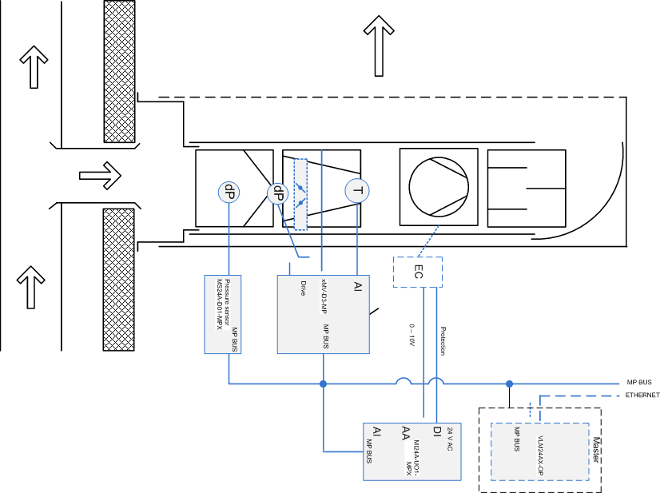
4. Implementation of the innovative air conditioning system
Typical outlet

Slide 20
Possible variants of outlet

Slide 21
5. Conclusions
The described innovative air supply system can offer customers, especially large shopping centres and malls clear and quantifiable benefits, beyond the usual optimization of the classical building automation systems.
The technical basis for this is the highly integrated electronics, through it is possible to network the intelligent nodes (sensors and actuators) powered over Ethernet all around the buildings.

Slide 22
5. Conclusions
The next phases of the project envisage the completion of the node with actuator and fault monitoring functions.

Slide 23
THANK YOU FOR YOUR ATTENTION!

